Slide 1
VBS on Steroids
Introducing Community Families to the Church Family

Slide 2
Sabbath Morning—why we do it
Connect with community families
Show-case a family-friendly church
Familiarize families with the building
Introduce the community to our church family
Let our church see their own outreach

Slide 3
Sabbath Morning—what we do
Preparing the Church
Talk up the opportunity
Shorten Sabbath School
Dress casual option
Encourage mingling
Vacation Bible School is THE Church Service

Slide 4
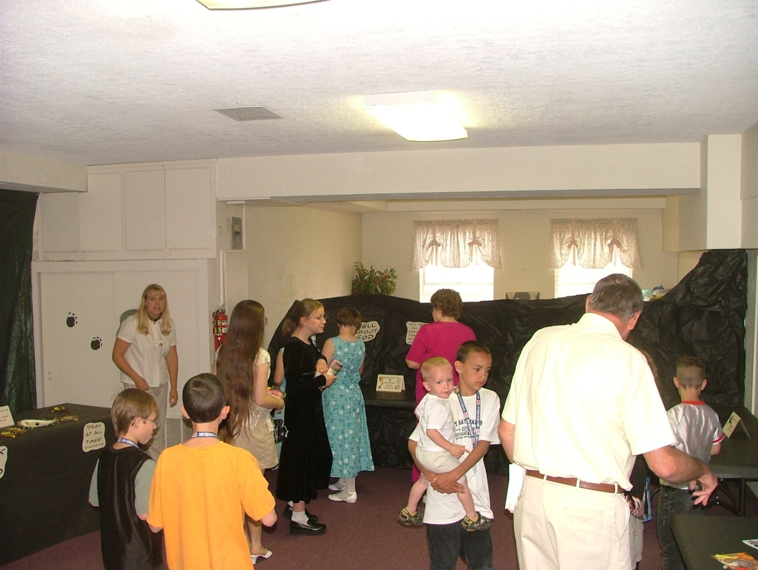
The Event: Open-House
10:30-10:50 Tours
Staff on site

Slide 5
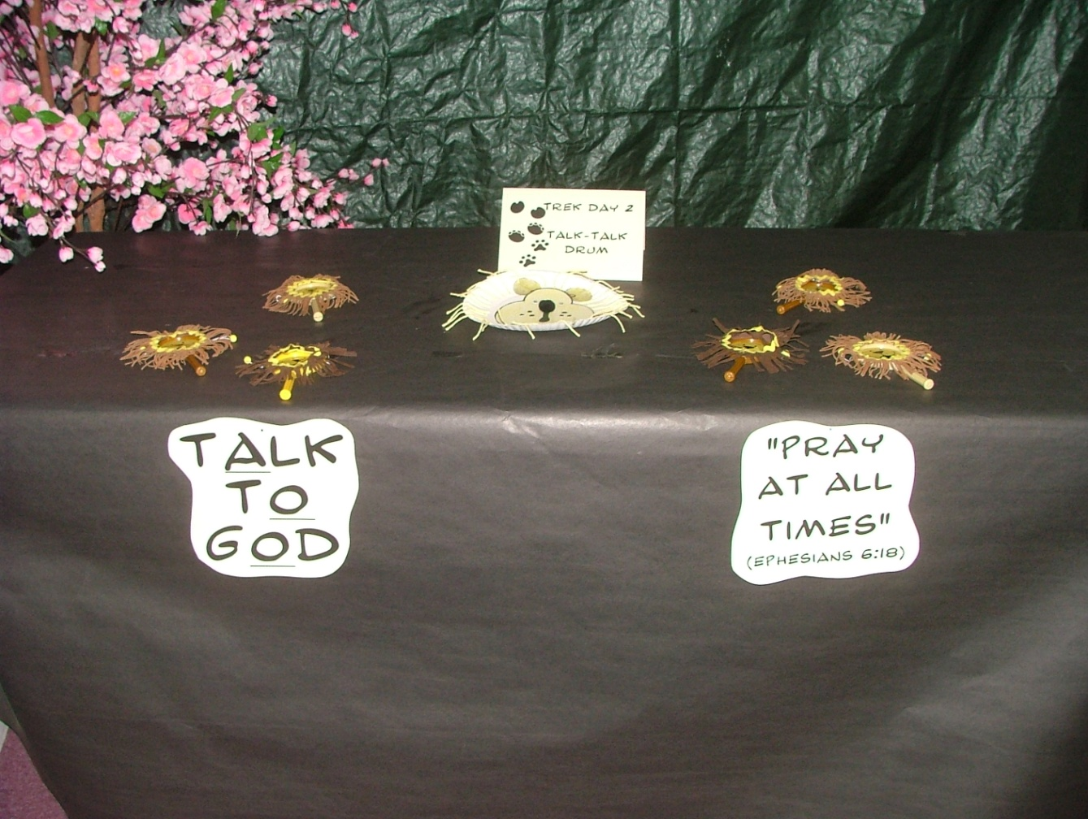
The Event: Open-House
10:30-10:50 Tours
Staff on site
Craft & Snack samples

Slide 6
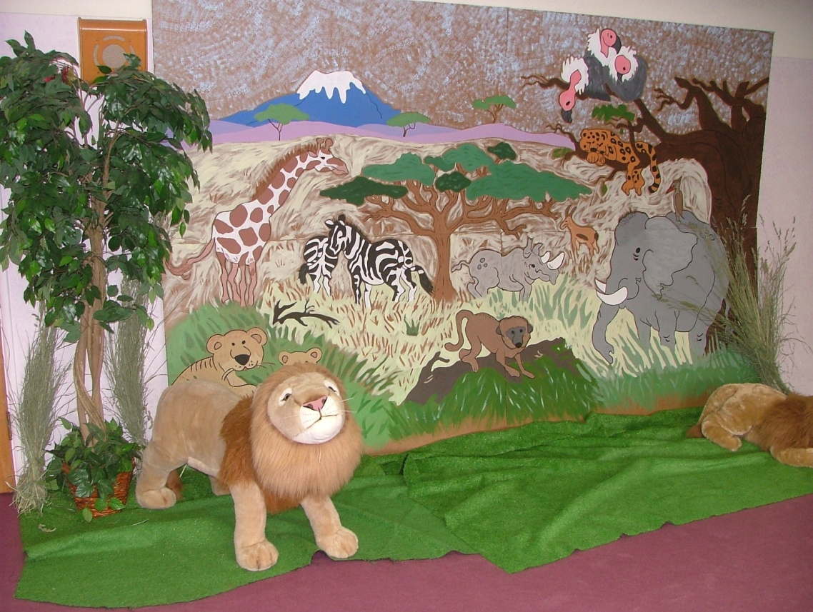
The Event: Open-House
10:30-10:50 Tours
Staff on site
Craft & Snack samples
Purpose
Gives members a sample of VBS
Parents feel church investment in kids

Slide 7
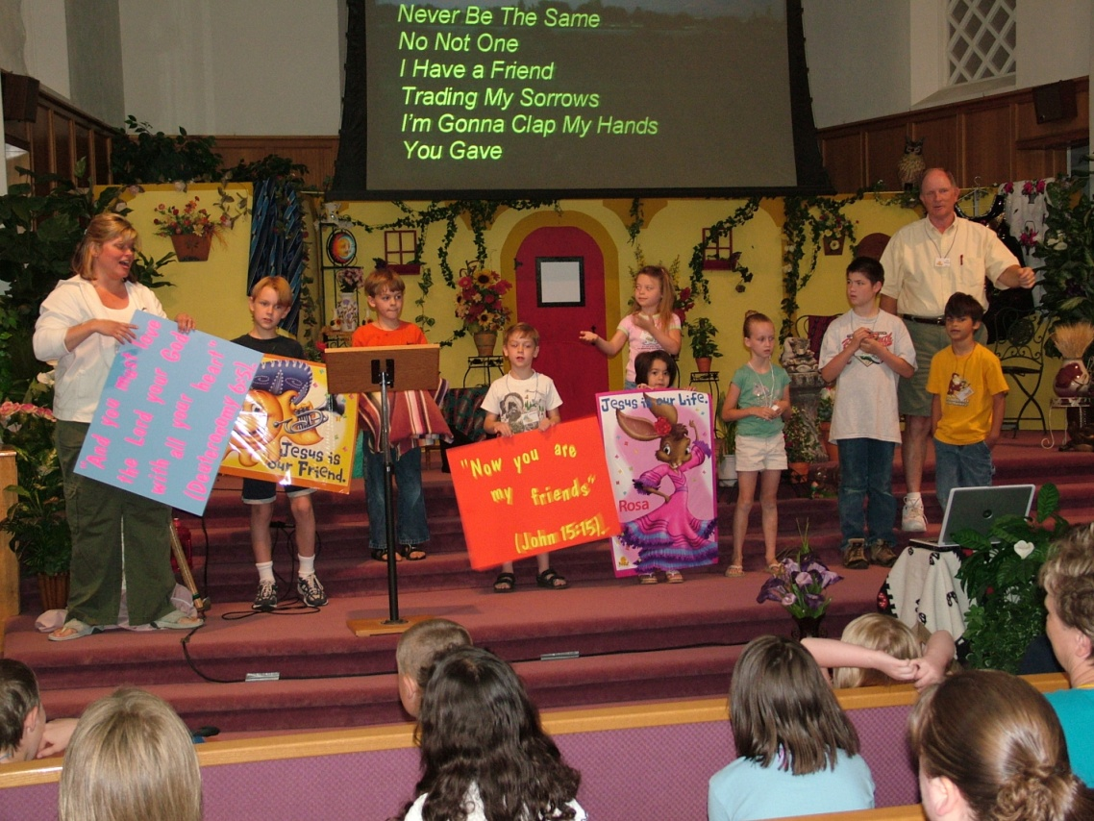
The Event: Church Service
The Program
Mini-VBS Main Event
Songs
Daily Points/Memory Verse
Video
Skit
Point for the Day

Slide 8
The Event: Church Service
Program Ideas & Strategies
Spotlight kids
Utilize mentored volunteers
Video give-away
Dream—DVD w/trailer
Kids get handout/buddy to remember lesson

Slide 9
The Event: Post-Service
Refreshments

Slide 10
The Event: Post-Service
Refreshments

Slide 11
The Event: Post-Service
Refreshments
Rationale
Extend connecting opportunities

Slide 12
The Event: Post-Service
Refreshments
Rationale
Extend connecting opportunities

Slide 13
Benefits
Breaks down barriers
Church sees, rather than just hears about outreach
Kid-emphasis for church
Creates an “Inviteable Event” with mingling opportunities
Capitalizes on week’s investment
High guest involvement

